Slide 1
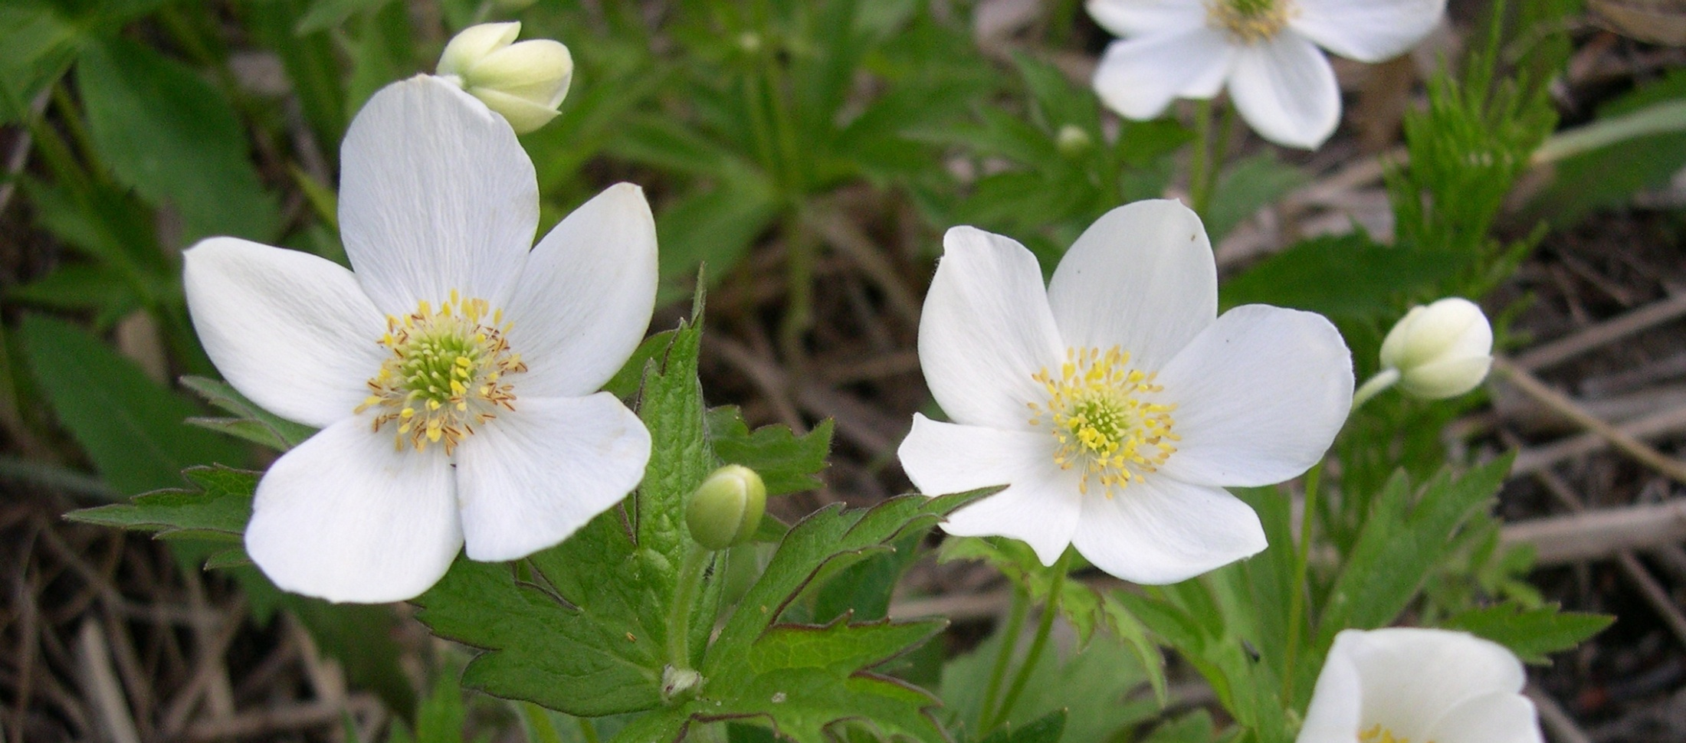
Identification & Management of Red and Blue Species/Ecological Communities and Species and Ecosystems of Management Concern
Prince George Business Area
BC Timber Sales
To advance each slide use 1 click of the mouse button.

Slide 2
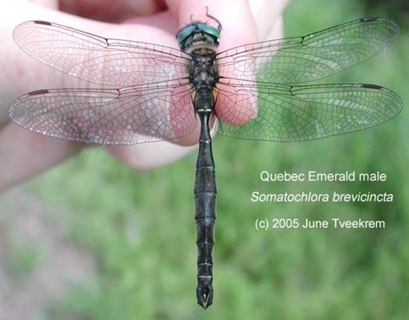
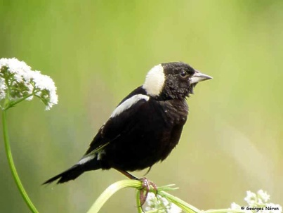
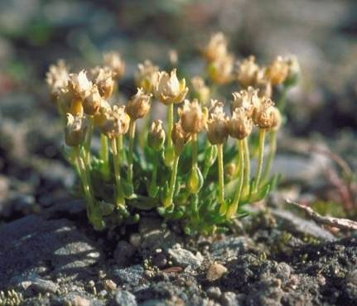
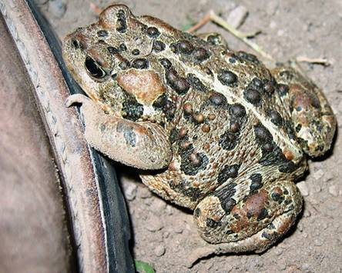
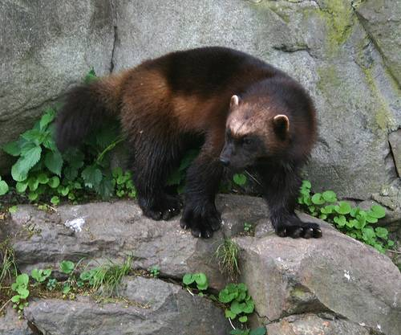
INTRODUCTION
This program was developed to provide Identification & Management of Red and Blue Species/Ecological Communities and Species and Ecosystems of Management Concern information and management guidelines for the BCTS PGBA.
It is intended to fulfill commitments made by BCTS for training in the PGBA.
Quebec Emerald – June Tveekrem
Bobolink – Georges Neron
Snow Pearlwort – Canadian Museum of Nature
Western Toad – Hugh S. McDonald
Wolverine – Mats Kempe

Slide 3
INTRODUCTION
The conservation of species and plant communities at risk is a fundamental component of sustainable forest management. Rare and endangered species, their habitats, and plant communities need to be addressed and managed with a particular level of urgency, due to their sensitivity to forestry practices.
It is therefore important for all forestry personnel to be capable of recognizing species and plant communities in the field, as well as maintaining an understanding of the various stand and landscape level management strategies available to address species at risk or sites of biological significance.

Slide 4
OBJECTIVES
How to access and utilise the current management strategies developed for the PGBA
Familiarity with the range of existing legislation available to protect species at risk in the PGBA and B.C.
How to respond when species at risk are encountered
Follow-up reporting structures
Appreciation of the number and the variety of species at risk occurring in the PGBA

Slide 5

WHY PROTECT SPECIES AT RISK?
Loss of Biodiversity means loss of:
  Genetic resources
  Productivity
  Ecosystem buffering
  Ecosystem services
  Aesthetic and commercial resources
Meadow Arnica - Jo-Ann Ordano

Slide 6
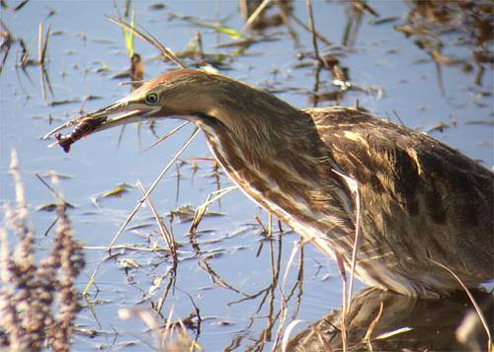

WHAT ARE SPECIES AT RISK?
Species that are listed as Extirpated, Endangered, or Threatened by COSEWIC – Committee on the Status of Endangered Wildlife in Canada (legal standing)
Species that are on the Red or Blue provincial lists
American Bittern – Janice Clark
Canada Anemone – Amelie Rousseau

Slide 7
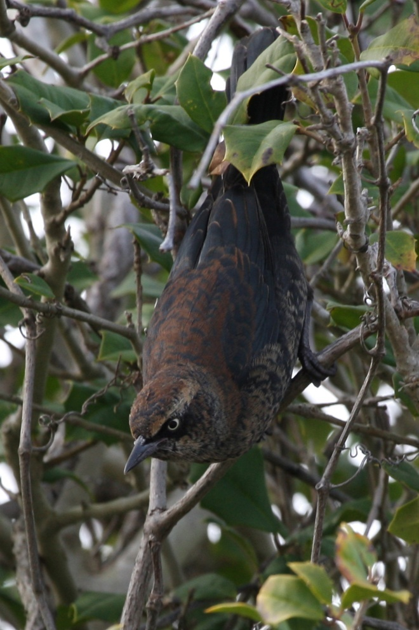
WHO DECIDES?
Nationally – species assessed by scientific panels as part of COSEWIC
  Use IUCN (World Conservation Union) objective criteria
  Population size, status of range, status of habitat
Provincially – Conservation Data Centre
  Based on criteria established by the international organization NatureServe
  Population size/trend, range, viability, threats, number of occurrences protected
Rusty Blackbird – Beth Starr

Slide 8
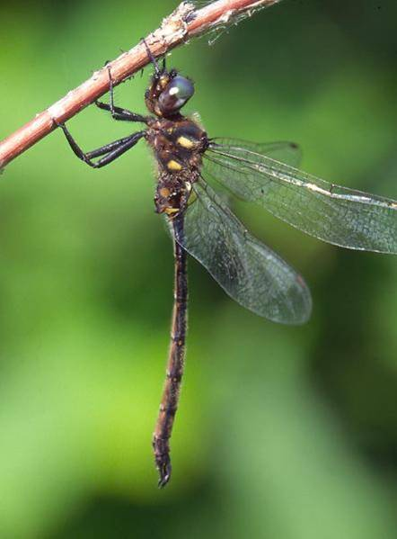
PROTECTION FOR SPECIES AT RISK
Federal
Species at Risk Act (SARA)
Provincial
Wildlife Act
Forest and Range Practices Act
Fish Protection Act
Forcipate Emerald - Blair Nikula

Slide 9
FEDERAL PROTECTION FOR SPECIES AT RISK
SPECIES AT RISK ACT (SARA)
The Species at Risk Act was proclaimed in June 2003, and is one third of a three-part Government of Canada strategy for the protection of wildlife species at risk. The Act is a key federal government commitment to prevent wildlife species from becoming extinct and secure the necessary actions for their recovery. It provides for the legal protection of wildlife species and the conservation of their biological diversity.
The purposes of the Act are to:
  Prevent Canadian indigenous species, subspecies, and distinct populations from becoming extirpated or extinct
  Provide for the recovery of endangered or threatened species
  Encourage the management of other species to prevent them from becoming at risk
Wolverine – Mats Kempe

Slide 10
FEDERAL PROTECTION FOR SPECIES AT RISK Continued
SPECIES AT RISK ACT (SARA)
More specifically, the Act will:
  Establish the COSEWIC as an independent body of experts
  Require that the best available knowledge be used
  Create prohibitions
  Recognize that compensation may be needed
  Create a public registry
  Be consistent with Aboriginal and treaty rights and respect the authority of other federal ministers and provincial governments
  This national strategy also includes commitments under the national Accord for the Protection of Species at Risk and activities under the Habitat Stewardship Program for Species at Risk.
Wolverine – Mats Kempe

Slide 11
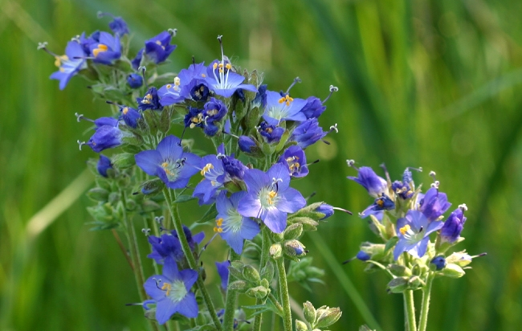
FEDERAL PROTECTION FOR SPECIES AT RISK
SPECIES AT RISK ACT (SARA)
Recovery planning in Canada has historically taken a species-by-species approach. Current national initiatives are recognizing the importance of incorporating a wider scope in recovery planning than single species recovery. This strategy takes a dual-level approach to recovery planning – the Ecosystem or coarse filter approach and the Species-specific or fine filter approach.
Ecosystem or Coarse Filter Approach
Species-Specific or Fine Filter Approach
The combination of applying both the coarse and fine filter approaches is designed to ensure habitats for all species are maintained.
Western Jacob’s-Ladder – Steve Matson

Slide 12
FEDERAL PROTECTION FOR SPECIES AT RISK Continued
SPECIES AT RISK ACT (SARA)
The Course Filter approach focuses on managing ecosystems and their natural processes and attempts to manage a broad range of habitats that are necessary to maintain the natural diversity of species, ecosystems, and ecosystem processes. This approach provides practices for the habitat for many species
Coarse Filter
Maintenance of biodiversity on a broad scale
Parks and protected areas
Provisions for managing seral distribution (OGMAs, WTRAs)
Management of riparian areas
Strategic and landscape-level planning
Western Jacob’s-Ladder – Steve Matson

Slide 13
FEDERAL PROTECTION FOR SPECIES AT RISK Continued
SPECIES AT RISK ACT (SARA)
The Fine Filter approach is necessary where coarse filter practices do not meet the needs of a particular species or a unique plant community. This approach protects the critical habitat for a particular species’ needs and provides practices and management strategies specific to them. Although ecosystem-level planning may be necessary for recovery of species at risk, it is generally insufficient. For this reason, a “fine filter” approach for directly addressing individual species is part of the recovery strategy.
Fine Filter
Wildlife Habitat Areas and associated Objectives and General Wildlife Measures
Wildlife Habitat Features
Stand level measures (e.g. coarse woody debris guidelines)
Western Jacob’s-Ladder – Steve Matson

Slide 14
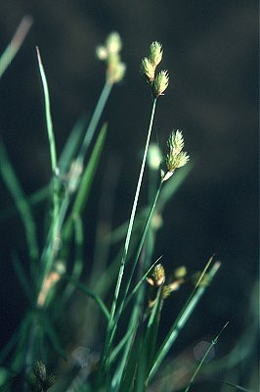
BC PROTECTION FOR SPECIES AT RISK
BC WILDLIFE ACT
  Main provincial law for protecting wildlife, endangered species and wildlife habitat
  Provisions for protecting, managing, and purchasing habitat areas as well as protecting endangered and threatened species
  Administered by the Ministry of Environment
The Act employs two primary vehicles for managing wildlife:
  Managing wildlife takings through licensing schemes and particular species protection measures
  Managing habitat areas
Robert W. Freckmann, University of Wisconsin- Stevens Point

Slide 15
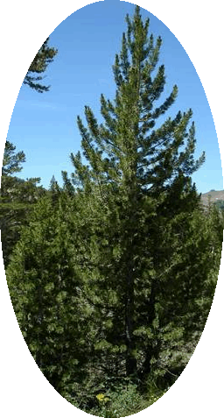
BC PROTECTION FOR SPECIES AT RISK
FOREST AND RANGE PRACTICES ACT (FRPA) and Regulations
  Govern the activities of forest and range licensees
  Sets the requirements for planning, road building, logging, reforestation, and grazing
  Designed to deliver a careful balance of economic and environmental benefits across the landscape simultaneously, and not one to the exclusion of the other.
  Specifies requirements to conserve soils, provide sustainable reforestation, and to protect riparian areas, fish and fish habitat, watersheds, biodiversity, and wildlife.
Various measures, such as:
  Identified Wildlife Management Strategy (IWMS)
  Wildlife Habitat Features (WHFs)
  Ungulate Winter Ranges (UWR)
  Wildlife Tree Retention Areas (WTRAs)
Whitebark Pine - © 2007 Dr. Mark Brunell

Slide 16
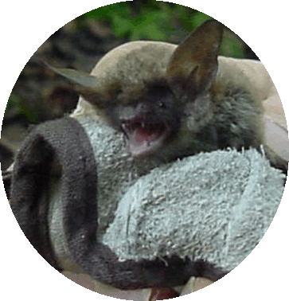
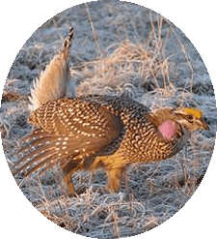
BC PROTECTION FOR SPECIES AT RISK
FOREST AND RANGE PRACTICES ACT
Identified Wildlife Management Strategy (IWMS)
Provides direction, policy, procedures and guidelines for managing identified Wildlife including all flora, fauna and plant communities
Includes Species at Risk and Regionally Important Wildlife (RIW) considered to require special management
Managed through the establishment of Wildlife Habitat Areas, implementation of General Wildlife Measures or other management practices specified in strategic or landscape level plans
Northern Myotis – Rob Robbins
Sharp-Tailed Grouse – Cindy Grey

Slide 17
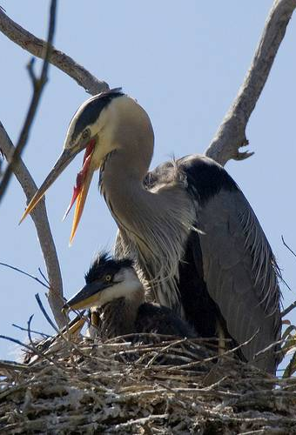
BC PROTECTION FOR SPECIES AT RISK
FOREST AND RANGE PRACTICES ACT
Wildlife Habitat Features
A feature used by a wildlife species for one or more of its important habitat requirements
Special management is required to ensure that these features are not damaged or rendered ineffective
Protects discrete habitat features that are readily identifiable in the field such as:
  Mineral licks or wallows
  Fisheries or marine sensitive features
  Nest site of a great blue heron or other bird species at risk
  Any other localized feature that is important for wildlife, especially SAR
Great Blue Heron Nest - Mike Baird, bairdphotos.com

Slide 18
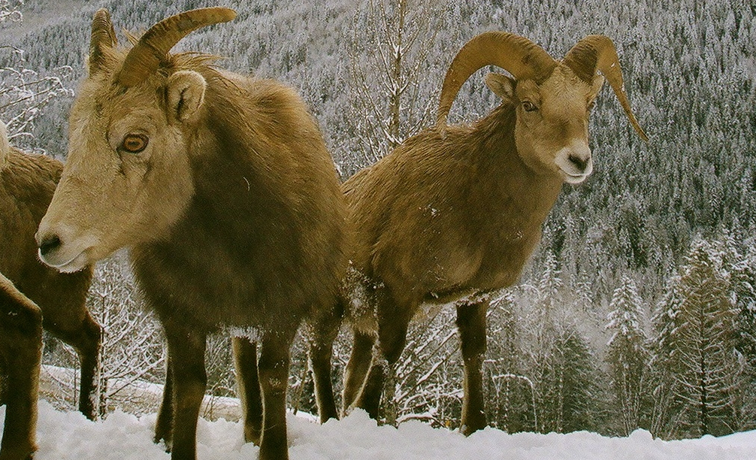
BC PROTECTION FOR SPECIES AT RISK
BC PROTECTION FOR SPECIES AT RISK
FOREST AND RANGE PRACTICES ACT
Ungulate Winter Ranges - management has been going on for over 20 years in some portions of the province. Formal legal establishment of Ungulate winter ranges and associated objectives began under the Forest Practices Code and continue, under the Forest and Ranges Practices Act.
Area that contains habitat that is necessary to meet the winter habitat requirements of an ungulate species (hoofed mammal)
Based on our current understanding of ungulate habitat requirements in winters by the Ministry of Environment regional staff from current scientific and management literature, local knowledge, and other expertise from the region
Bighorn Sheep – Cody Biles

Slide 19
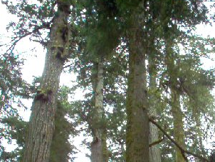
BC PROTECTION FOR SPECIES AT RISK
FOREST AND RANGE PRACTICES ACT
Non-Spatial Old Growth Order and Spatial OGMAs - The word “non-spatial” is used to differentiate this order – which defines target amounts but not specific areas to be retained – from those orders that “spatially” describe actual old growth management areas.
  Legally establishes new landscape units as well as old growth forest retention objectives
  Confirm the extent of timber harvesting opportunities
  Clear action to conserve biodiversity value and species associated with old growth forests
  Delineated within landscape unit plans to address landscape level biodiversity
  Designed to reflect the composition of the landscape
  Selected from the non-contributing land base

Slide 20
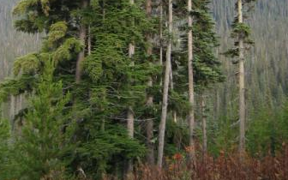
BC PROTECTION FOR SPECIES AT RISK
FOREST AND RANGE PRACTICES ACT
Wildlife Tree Retention Areas
Important stand level habitat features which provide vertical stand structure and a source of coarse woody debris
Retention in patches or clumps is the preferred method
Remnant or representation of the pre-harvest forest
Provides additional habitat values over individual trees, including security cover for a wide variety of species; thermal cover from heat, cold and wind; and snow interception
Protect forest structure to contribute older forest attributes throughout the rotation
More than 80 vertebrate species known to depend on wildlife trees
Ensure the species diversity is maintained at the stand level and over the larger landscape

Slide 21
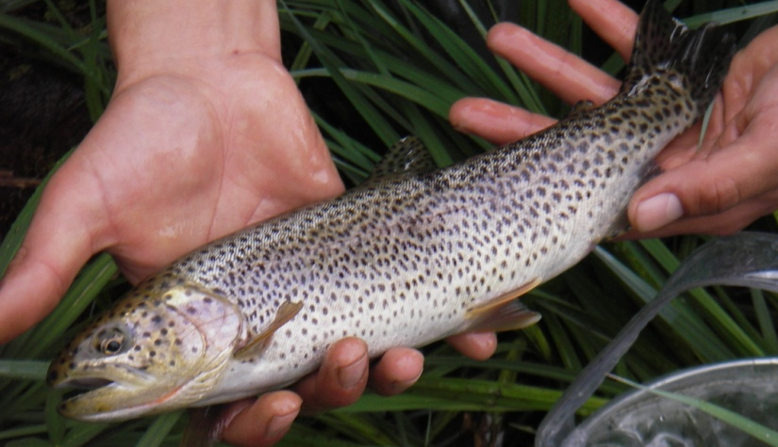
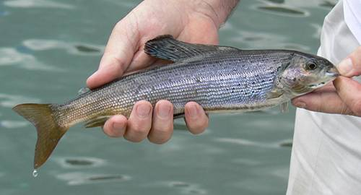
BC PROTECTION FOR SPECIES AT RISK
BC FISH PROTECTION ACT
To ensure fish and fish habitat are sustained for present and future generations. It aims to balance the needs of fish with the needs of people, to the benefit of both.
Four major objectives:
  Ensuring sufficient water for fish
  Protecting and restoring fish habitat
  Improved riparian protection and enhancement
  Stronger local government powers in environmental planning
Addresses water levels, riparian habitat and designation of sensitive streams
Cutthroat Trout - Kirsten MacKenzie
Arctic Grayling - Christopher Leavell - http://www.leavellphoto.com

Slide 22
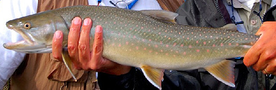
BC PROTECTION FOR SPECIES AT RISK
BC FISH PROTECTION ACT
Riparian Areas Regulation
Purpose:
Provide protection for the features, functions and conditions that are vital in the natural maintenance of stream health and productivity
Riparian Areas:
Occur next to the banks of streams, lakes, and wetlands
Include both the area dominated by continuous high moisture content and the adjacent upland vegetation that exerts an influence on it
Contain many of the highest value non-timber resources
Frequently contain the highest number of plant and animal species found in forests, and provide critical habitats, home ranges, and travel corridors for wildlife
Degree of protection dependent on stream size, and whether it is fish-bearing or in a community watershed
Focus is on protecting attributes of the in-stream habitat
Guidelines may provide inadequate protection for some semi-aquatic or terrestrial species associated with riparian habitat
Bull Trout – Phil Fischer

Slide 23
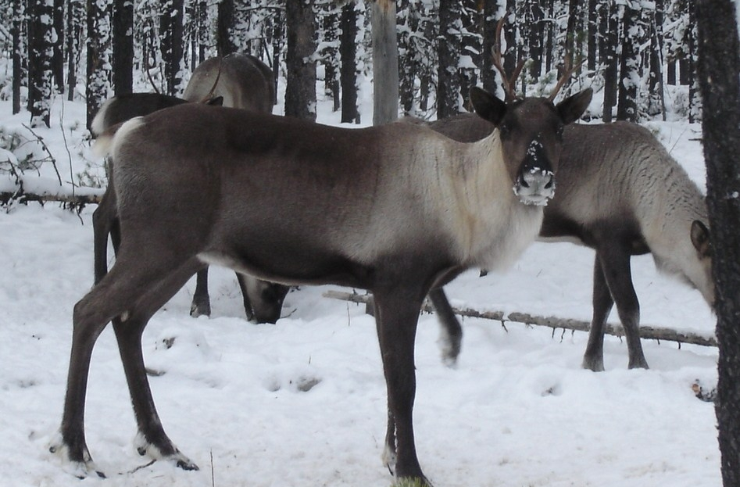
RANKING SPECIES AT RISK
Ranking or Status:
The inclusion of species and plant communities in this training was based on the ranking or status given to them by the following organizations:
Identified Wildlife Management Strategy (IWMS); red- and blue-listed species selected by the Technical Advisory Committee,
The Committee on the Status of Endangered Wildlife in Canada (COSEWIC); species that are ranked endangered or threatened,
The Conservation Data Center (CDC); red- and blue- listed species
Woodland Caribou – Elena Jones

Slide 24
RANKING SPECIES AT RISK Continued
Ranking or Status:
The ranking of all wildlife, including plant communities, is based on factors such as rarity; the size, quality, conditions, and viability of the populations; and actual or potential threats facing the species or its habitats:
Single global (G) rank on a scale of 1 to 5
G1 – Critically Imperiled
G2 – Imperiled
G3 – Vulnerable
G4 – Apparently Secure
G5 – Secure
They are also assigned a national Canada-wide (N) rank; and a subnational (S) rank using the same 1-5 scale that reflects its provincial conservation status.
Woodland Caribou – Elena Jones

Slide 25
RANKING SPECIES AT RISK
The CDC separates species into three lists according to conservation risks:
  Red List – species that have been legally designated as endangered or threatened under the British Columbia Wildlife Act. These species have S ranks of 1, 2, 1-2, 1-3, H or X
  Blue List – species not immediately threatened, but of concern because of characteristics that make them particularly sensitive to human activities or natural events. These are species with S ranks of 2-3, 3, or 3-4 (animals only)
  Yellow List – all species not included in the Red or Blue lists. These species have S ranks of 4, 5, 4-5, or 3-4 (plants only)

Slide 26
BC Species and Ecosystem Explorer.
The Prince George Business Area utilizes a pro-active, live and up-to-date approach to ensuring identification and necessary protection of provincial Red and Blue Species/Ecological Communities and Species and Ecosystems of Management Concern, when planning development activities. This specifically relates to planning processes associated with: multiphase, harvesting, road construction and road deactivation.
It is the responsibility of staff and contractors to be aware of the number of potential species and plant communities at risk that they may encounter while conducting their field work.
Link to BC Species and Ecosystem Explorer site: http://www.env.gov.bc.ca/atrisk/toolintro.html

Slide 27
Using BC Species and Ecosystem Explorer.
Procedure
1. BCTS staff and associated layout contractors will use BC Species and Ecosystems Explorer to identify:
  • Provincial Red and Blue Species/Ecological Communities and Species and Ecosystems of Management Concern, by applicable Forest District within the Business Area.
  • The relevant publications to aid in identification of red and blue listed species and ecological communities.
  • Source material related to Species distribution, life histories, conservation needs, recovery plans and more. The BCTS Management Strategies will be provided to assist contract staff in determining appropriate BCTS PGBA management Direction.
2. Link to the appropriate Species and Ecosystems Explorer website: http://www.env.gov.bc.ca/atrisk/toolintro.html

Slide 28
Using BC Species and Ecosystem Explorer Continued.
3. Utilise the following procedure to establish a list of the red and blue listed species and ecological communities found within the Prince George, Robson Valley and/or Mackenzie portion of the BA:
Click on Start to launch Application
  Plants and Animals, or Ecological Communities >>> Must select one or the other.
You can either do a Quick Search (Everything) or a Basic Search (More specific) – I prefer Basic
  Species Name >>> Search Type - Select combined Scientific and English.
  Species Groups >>>Search Type
Then under Advanced Search >>> Select Area Based:
  Forest District >>> Select Prince George, Robson Valley, or Mackenzie as appropriate.
  BGC Zones >>> Optional but can help Narrow scope
Conservation Status >>> Select BC List >>> Select Red List and Blue List.
Sort by English Name.
Search
As per the search criteria, a list of records will be indicated, that can be printed and/or exported in digital format. Individual species summaries and associated reports can be printed to aid staff and contractors in field identification of the species and ecological communities.

Slide 29
Using BC Species and Ecosystem Explorer Continued.
4. Impacts to Provincial Red and Blue Species/Ecological Communities and Species and Ecosystems of Management Concern will be managed as per the process identified in TPG Management Strategies Document and the species lists updated from the CDC.
5. BCTS pre-works associated with harvesting, road construction, and road deactivation projects will confirm the relevant Red and Blue Species/Ecological Communities and Species and Ecosystems of Management Concern pertaining to the development area.
6. LPC’s are responsible to ensure their staff are knowledgeable of: the BCTS planning process and associated training pertaining to species at risk, the red and blue species that may potentially be found within the development area and the appropriate resources (as provided within BC Species and Ecosystems Explorer) necessary to identify the occurrence of Red and Blue Species/Ecological Communities and Species and Ecosystems of Management Concern in the field.
7. Upon completion of planned development, the multi-phase contractor / signing forester preparing related site plans must complete an associated site plan check list, indicating the presence or absence of any Red and Blue Species/Ecological Communities and Species and Ecosystems of Management Concern. Where warranted (and in co-ordination with the BCTS representative), appropriate text and mitigative measures must be included in the site plan.

Slide 30
TPG SPECIES MANAGEMENT STRATEGIES
TPG has separated out the management strategies into 3 broad categories.
Animal Management Strategies. This management strategy includes the mammals, fish, birds, and invertebrates and involves grouping together of species into similar habitat requirements.
Vascular Plant Management Strategies. All vascular and non-vascular plants are managed in a similar fashion – Record, Collect, Confirm, and Implement a suitable stand level management strategy.
Plant Community Management Strategies. All plant communities are managed in a similar fashion as well. Management of plant communities usually involves a recognized professional (ecologist) in conducting a field assessment of the quality, location, and size of the potential plant community at risk. General management guidelines are provided.

Slide 31
RECORDING AND REPORTING
All incidences of species or plant communities at risk must be recorded and reported to BCTS and the CDC.
BCTS forms are provided on ftp site. BCTS staff must fill this form out and submit to the planning department. Contractors are to fill out this page as well and provide to the contract coordinator.
Contractors must also complete the online reporting to the CDC. The CDC online link is provided below. Access to the site must be requested. A valid BCEID or government IDIR is required to access this reporting function.
Link to CDC online reporting: http://www.env.gov.bc.ca/cdc/contribute.html

Slide 32
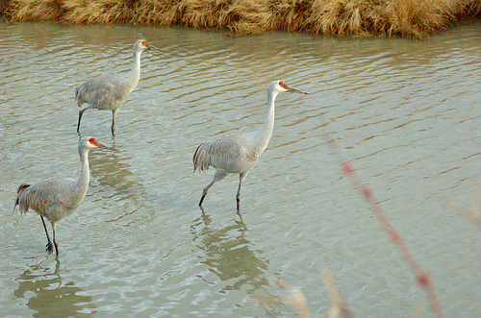
CONCLUSION
Managing species and plant communities at risk is a challenge for everyone
Very few ‘absolutes’ to guide resource managers
Each stand, watershed, disturbance unit and planning area has unique problems that require creative solutions
It should be understood that the information in the training has been provided to assist with the conservation as the main objective
Success evaluated by maintaining all species and plant communities through time
In the PGBA, there are still many opportunities to conserve biological diversity at the stand and landscape level
Sandhill Crane – Peter Lypkie

Slide 33
RESOURCES AVAIULABLE
Prince George-Sustainable Forest Management System External webpage: http://www.for.gov.bc.ca/bcts/areas/TPG/TPG_SFM.htm
Click on Link to Business Area to access the FTP
Click on Species-at-Risk-Awareness-Training
Or, you can find all this applicable information directly on the FTP site at:
https://gww.for.gov.bc.ca/ftp/TPG/external/!publish/Species%20at%20Risk/
Once in you will find:
May 2013 Management Guide (Current version)
BCTS Forms and Info
PG BCTS strategies April 2012 update (Current Version)
SAR General Mgmt Strategies TPG 2015 (Current Version)
SAR Planning Process 2014 (Current Version)
Species at Risk TPG 2016 PowerPoint (Current Version)
Note: All the above resources and familiarity with them comprise the full training package.

Slide 34
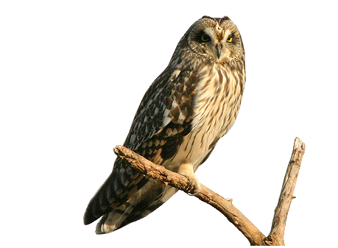
CONGRATULATIONS
You have now completed the Training!
If you are a BCTS staff member, notify your supervisor of your completion of this training.
If you are a contractor assigned to train your employees, provide your contract coordinator with a list of employees that you have trained and the associated training dates.
Review and become familiar with the information provided on the ftp site.
Short-Eared Owl – Ralph Hocken

